Slide 1

Seminar – Week 3 Insider Threats and Threat Analysis Scenario Lecturer - Martin Sparrius
CSFIS – Week 3

Slide 2
Plan for this session
Job role: Information Security Analyst
Introduction the Common-Sense Guide and insider threats
(Task) - Threat Intelligence Scenario
Preparing for the 1st Engagement Task

Slide 3
Pentration Tester
A Pen Tester’s job is to attack an organisation’s computer systems and network and report on any discovered vulnerabilities.
Some of their duties involve:
Regular security checks of core systems (email etc.)
Creating and running specific attacks to test a specific aspect (phishing)
Researching new security technologies
Average salary: £25,000 to £56, 700 (location specific)
Entry qualification: Information Security or Computing BSc

Slide 4
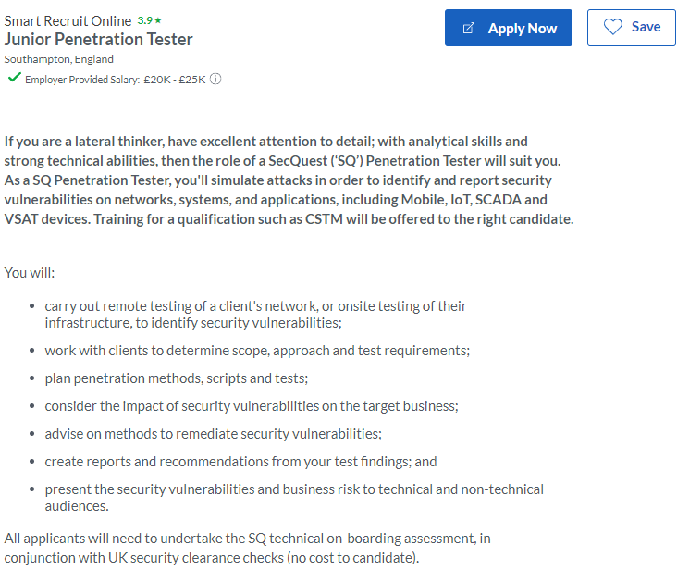
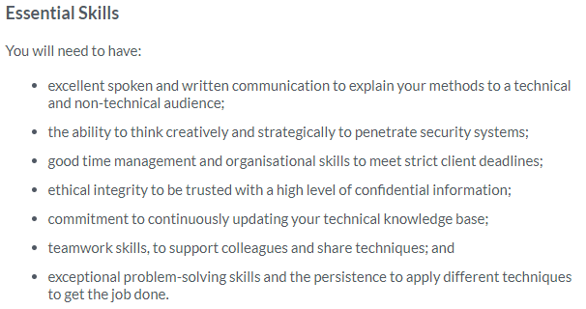
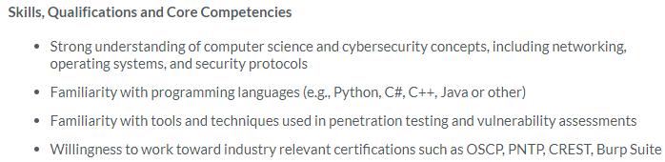
Penetration Tester
Glassdoor - Pen testing

Slide 5

Insider threats
https://www.theguardian.com/news/2022/feb/20/credit-suisse-secrets-leak-unmasks-criminals-fraudsters-corrupt-politicians

Slide 6
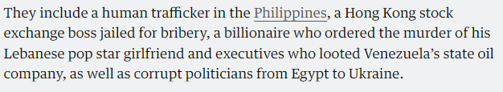
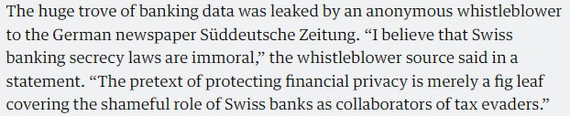
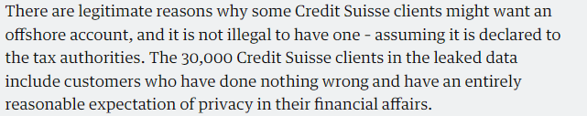
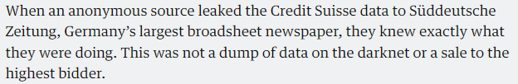
Credit Suisse

Slide 7
What is an Insider threat?
Someone trusted to work within a system but who does not work in that system’s interests is described as an insider threat.
Insider threats take many forms, including:
fraud (such as someone working in a bank diverting money to accounts under their control)
improper access to confidential data (such as commercially or politically sensitive material, for instance, diplomatic cables)
the sabotage of computer systems (for instance, destroying backup data).
A more clear cut example
In February 2018, Hong Kong police arrested 34-year-old Muhammad Fahd on behalf of the US Department of Justice (U.S. Attorney’s Office, 2019). Fahd was extradited to the US in 2019 and charged with 14 offences including defrauding the telecom operator AT&T by illegally unlocking mobile phones sold on instalment payment plans. Between 2012 and 2017, Fahd recruited a network of AT&T call centre employees to not only unlock phones but also install malicious software on the AT&T network.

Slide 8
Factors which increase Insider threats
Economic Factors
Losing their job, having a pay cut or just general job insecurity can lead employees to become hostile towards their organisation
Political and Social Factors
Political, social and behavioural conflicts can all result in employees turning hostile. It might not even be something your company did, just where you are based out of.
National factors
Your employee might find themselves more strongly affiliated with a nation state than they are to your organisation
Just plain old Spying
Organisations with commercially advantageous information will be targeted with ‘moles’ to extract this information

Slide 9
Unintentional Insider Threat
Sometimes people just make mistakes or stumble upon information they shouldn’t have access to.
A formal definition is.
An unintentional insider threat is a current or former employee, contractor, or business partner who has or had authorized access to an organization’s network, system, or data and who through action or inaction without malicious intent unwittingly causes harm or substantially increases the probability of future serious harm to the confidentiality, integrity, or availability of the organization’s resources or assets, including information, information systems, or financial systems.
Some examples are:
Forgetting to log off or lock a workstation
Misaddressing email messages
Losing an USB drive

Slide 10
Characteristics of Insider threats
Frustration: Many attackers had troubled family histories or difficult personal circumstances. This was reflected in negative attitudes towards authority (such as policies and security controls)
Computer dependency: Rather than social and professional relationships with their colleagues, attackers preferred to engage in online activity. Some of these people admitted to enjoying the challenge of breaking security controls and accessing data they were not permitted to view.
Ethical flexibility: Attackers did not consider their actions unethical and some considered them justified.
Reduced loyalty: The researchers discovered that many attackers preferred to be associated with their profession or specialist interest rather than their employer.
Entitlement: Many attackers believed they had special privileges and that certain rules or workplace behaviours did not apply to them.
Lack of empathy: Many attackers did not recognise the potential, or actual, impact of their actions.

Slide 11
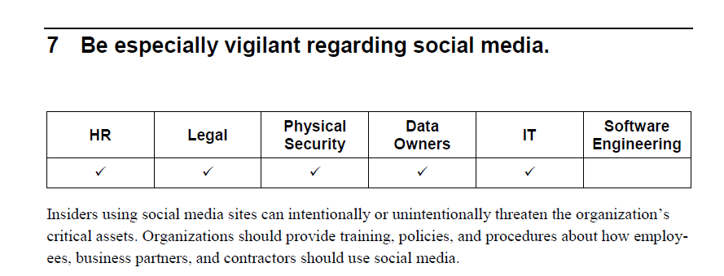
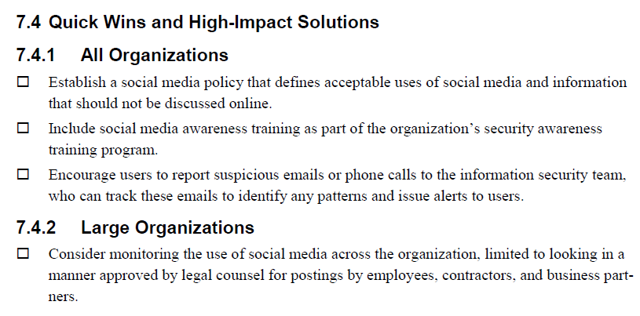
Countering Insider threats
Carnegie Mellon University have to put together a Common Sense Guide to Mitigating Insider Threats
Based on the analysis of 1500 cases of insider threats and recommends 21 practices that can be used to detect and prevent insider threats.
The Common Sense Guide

Slide 12
Presenting Threat Intelligence
In groups of 2-4 read through the attached resource and create a short email detailing:
If there a realistic threat (read up on the technology/business sector)
What does the threat entail
Are any measures being undertaken to mitigate the threat
Is there a cause for further concern
Resource – Email chain
Make use of subject action words and BLUF (Bottom Line Up Front)
Clear subject for the email
Conclusion at the start (this is not a summary)
Provide clear rationales
Descibe key issues and their resolutions
https://hbr.org/2016/11/how-to-write-email-with-military-precision

Slide 13
Engagement Tasks
There will be 3 engagement tasks and they are worth 5% of your total grade.
Criteria | Marks
All tasks completed to a high level (65% average) | 5%
All tasks completed to a good level (60% average) | 4%
2 tasks completed to a good level (60% average) | 3%
2 tasks completed to an acceptable level (50% average) | 2%
1 task completed an acceptable level (50%) | 1%

Slide 14
Engagement Tasks
Task 1. Introduction to Cyber Security Incidents
There have been several major cyber security incidents over the last several years, but the reporting of these incidents isn’t always correct or complete. Your task is to conduct a review of the published material for one of the following incidents and produce a 500-word summary of the event.
List of Incidents
Microsoft Exchange Data Breach (2021) - https://www.nbcnews.com/tech/security/u-s-issues-warning-after-microsoft-says-china-hacked-its-n1259522
Twitter Hack (2020) - https://edition.cnn.com/2020/07/15/tech/twitter-hack-elon-musk-bill-gates/index.html
SolarWinds Hack (2020) - https://www.reuters.com/article/global-cyber-idUSKBN28O1Z3
Capita Data Breach (2023) - https://www.theguardian.com/business/2023/apr/20/capita-admits-customer-data-may-have-been-breached-during-cyber-attack
Costa Rican Government Ransomware attack (2022) - https://www.bleepingcomputer.com/news/security/costa-rica-declares-national-emergency-after-conti-ransomware-attacks/

Slide 15
Engagement Tasks
Task 1. Introduction to Cyber Security Incidents
It is strongly recommended that you address the following:
What happened (timelines, key dates or events)?
What caused the incident (technical or human vulnerability)?
What needed to happen to address the vulnerability?
What was both short- and long-term damage of the incident?
Key skills which will be assessed in this are:
The use of research tools (like Google)
The ability to concisely present information
The ability to cite and reference using APA7 - https://library.port.ac.uk/ref/page2.html#t2
Suggested structure:
Introduction (100 words)
Body (400 words)
List references (not counted towards to word count)

Slide 16
Any questions?

